Slide 1
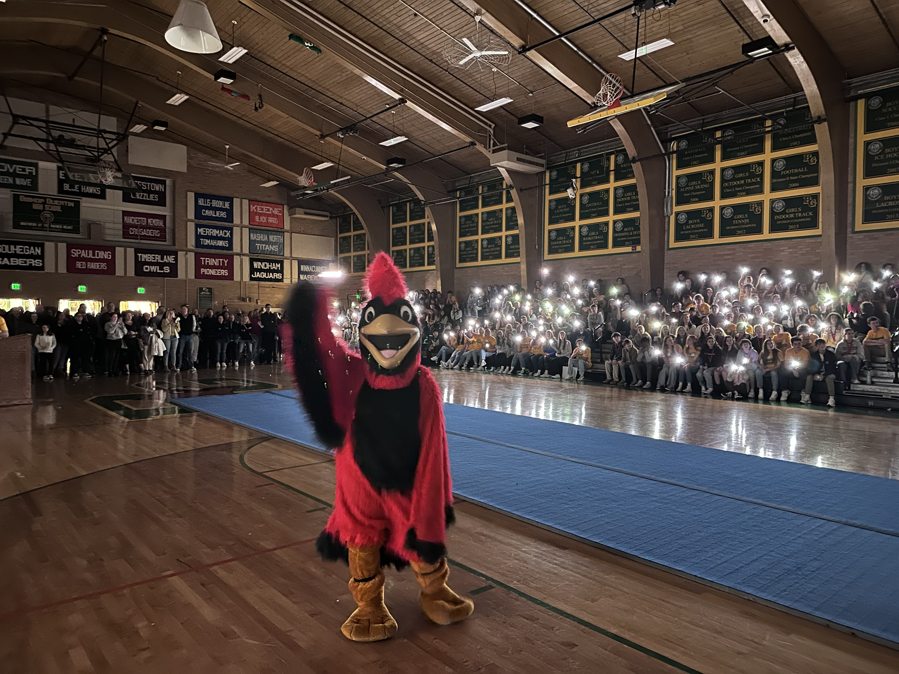
Class of 2027 Course Selection Information Night April 4, 2023

Slide 2
Mrs. Linda Brodeur
President
Prayer

Slide 3
Tonight’s Agenda
Welcome/Agenda Mrs. Brenda Poznanski
Opening Prayer Mrs. Linda Brodeur
The Academic Process Mrs. Brenda Poznanski
Introductions
In Your Packet
Graduation Requirements Mrs. Jill Leonard
Daily Schedule
Four Year Plan Mrs. Andrea Tencza
Course Selection Ms. Futrell and Mr. Mullin
Placement Exams Mrs. Poznanski
Technology Mr. Jason Strniste
Mark Your Calendars Mrs. Jill Leonard
Summer Enrichment Mrs. Lisa Futrell
Student Activities Night Mrs. Brenda Poznanski
Reminders
Homework Mr. Jason Strniste

Slide 4
Mr. Gurall
Vice Principal
The Academic Process

Slide 5
Introductions
Administration
Mrs. Linda Brodeur President
Mr. Jason Strniste Principal
Mr. Dan Gurall Vice Principal
Mr. Robert Forrester Dean of Student Formation
Mrs. Brenda Poznanski Director of School Counseling & Admission
Counseling Department
Ms. Lisa Futrell School Counselor
Mrs. Jill Leonard School Counselor
Mr. Dylan Mullin Assoc. Director of School Counseling
Mrs. Andrea Tencza School Counselor
Ms. Leigh Alcorn Administrative Assistant

Slide 6
Introductions
Department Chairs
Mr. Tom Indelicato Computer Science
Mrs. Bethany Prunier English
Mrs. Linda Fletcher Fine Arts
Mr. John Trisciani Health and Physical Education
Mrs. Jane Wielgozinski Mathematics
Mr. Bruce Miller Science & Math Coordinator
Mr. Mark Phillips Social Studies
Mrs. Beth Raymond Theology
Mr. Dan Gioffre World Languages

Slide 7
In Your Packet
Letter from the Director
Course Selection Instructions (yellow)
Student’s School Records Release Form
Placement Exam Registration (bright pink)
Greek and Latin Brochure
Program of Studies (POS)
Timeline (blue)
Fine Arts Information Sheet (green)
Leveling Brochure

Slide 8
Theological Studies 4.00
English 4.00
Mathematics 3.00 +
Science 3.00 +
Social Studies 3.50
World Language 2.00
Health and Fitness 1.50
Computer Science 1.00
Fine Arts 1.00
Electives remaining credits TOTAL: 24.00
Graduation Requirements
All students in the class of 2027 must earn 24 credits to graduate. All academic subjects that meet for a full year are given one credit and half year classes receive .5 credit.

Slide 9
BG Daily Schedule
7:45 – 7:55 | Advisory | Advisory | Advisory | Advisory | Advisory | Advisory | Advisory | Advisory
7:59 – 8:55 | A | G | E | C | B | H | F | D
8:59 – 9:55 | B | H | F | D | C | A | G | E
9:59 – 10:55 | C | A | G | E | D | B | H | F
10:59 – 12:25 30 minute lunch | D | B | H | F | E | C | A | G
12:29 – 1:25 | E | C | A | G | F | D | B | H
1:29 – 2:25 | F | D | B | H | G | E | C | A

Slide 10
 | 9th |  | 10th |  | 11th |  | 12th
Computer Science | Expl. CS |  | ½ Credit CS Elective in 3 Years
English | Intro to Lit |  | World Lit |  | American Lit |  | British Lit
Fine Arts | Art |  | ½ Credit Art Elective in 3 Years
Health & Fitness | PE |  | Health | ½ Credit PE over 3 Years
Mathematics | Algebra I |  | Geometry |  | Algebra II |  | Trig/Pre-Calc
Theological Studies | The Bible |  | Catholicism |  | Catholic Ethics and Philosophy |  | Elect. | Elect.
Science | Biology |  | Chemistry |  | Elective |  | Physics
Social Studies | Ctznshp & Gov’t |  | World History |  | US History |  | Econ | Elect.
World Language | Sp/Fr/La |  | Sp/Fr/La |  | Sp/Fr/La |  | Sp/Fr/La
Electives

Slide 11
The Bible 1.00
English 1.00
Algebra 1 1.00
Biology 1.00
World Language 1.00
Citizenship and Government .50
PE .50
Fine Art elective .50
Computer Science .50
Typical 9th Grade Schedule (7 credits)

Slide 12
Directions
Use Chrome or Firefox when accessing MYBG course selection
This process is through the Parent Portal
In order to choose courses both parents must have opened an account on the portal
In the case of a single parent or other circumstances regarding Registration please contact Sue Connolly in our Business Office
connollys@bghs.org
Course Selection

Slide 13
Log into MyBG through the Parent Portal
Click in the upper left-hand corner of the screen to select your child
Click on the Course Request button
Courses are prescribed in many areas so they have already been assigned and can be seen on the right-hand side of the page
Portal opens at 9pm tonight and closes at 8am on April 14thDirections were enclosed in the packet that was mailed to you and we will revisit tonight
Remember – students do not major in any discipline in high school!!
Course Selection

Slide 18
BIOLOGY - the majority of freshman will be enrolled in this course
BIOLOGY HONORS - this course is by invitation only (contact with family will be through email)
INTRO to ENVIRONMENTAL SCIENCE - this course is by invitation only (this course is an elective)
CHEMISTRY HONORS - this course is by invitation only and based on math placement as described in the POS
Science Options

Slide 19
FRENCH and SPANISH I - the majority of freshman will be enrolled in one of these courses
LATIN I HONORS - this course is for a student who really wants to have a World Language experience that will transcend the curriculum. This course is honors level not necessarily because of difficulty but because of depth and breath.
FRENCH and SPANISH II HONORS- this course is for students who have had a year or two of language in Middle School and by placement test only
World Language Options

Slide 20
Placement in honors level courses are done in two ways:
1. Review by Department Chair
2. Placement Exam
Review by the Department Chair is done for honors placement in Introduction to Literature and Biology. Chairs will review the student’s application materials and entrance exam to determine placement.
Placement Exams (bright pink sheet in your packet) Placement exams are required for any student who is interested in moving above the freshman year course or level in World Language and Math.
How is Placement Determined?

Slide 21
Who and why would a student take a placement exam?
Example 1: Based on previous study the student is interested in Spanish 2 or Spanish 2 honors. Student would sit for the Spanish Placement Exam.
Example 2: Student has already taken Algebra and wants to go into Geometry: the student would sit for the Geometry exam.
Example 3: Student is advanced in Math has already taken Geometry and would like to go to Algebra 2 or beyond; the student would sit for the Algebra 2 exam.
Placement Exam Dates: May 6th and May 9th.
Placement and Placement Exams

Slide 22
All students are required to bring at least one Personal Learning Device to school.
This does not mean that every student must go out and purchase a high-end device before school.
We make every effort to be open to different platforms and devices.
Bring Your Own Device

Slide 23
Academic Devices
MOST RECOMMENDED
Windows Laptop w/ Keyboard (or Surface)
Mac Laptop w/ Keyboard
Windows Netbook
Chromebook
Android Tablet, iPad
Phones / iPods
LEAST RECOMMENDED

Slide 24
Starting July 10
Summer Enrichment classes offered are…
Algebra Preview
Algebra Review
Reading and Writing
Study Skills (mid-August)
Boot Camp (August 4th)
Summer Enrichment

Slide 25
There is a Timeline of what to expect in the coming months in
your packet (blue sheet) – these are some highlights:
April 4 Course Selection Portal Open
April 14 Portal Closes
May 6 and 9 Placement Exams
June 9 Packet of information that includes student login, preliminary academic schedule, uniform order form, summer reading book list, school calendar, etc.
June 15 Student Activities Night
July 10 Summer Enrichment begins
August 21 New Student Orientation
August 22 First Day of School
Mark Your Calendar

Slide 26
June 15, 2023, at 6:30
All Cardinals are asked to involve themselves in the co-curricular programs of the school. Participation in a variety of activities contributes to the whole-person formation of each student.
All new parents and students please join us to learn about extracurricular and athletic opportunities at Bishop Guertin. Important co-curricular and key Student Life policies will be reviewed.
Student will have and opportunity to meet coachers, student leaders, and club moderators.
Student Activities Night

Slide 27
The Portal opens tonight at 9pm and closes April 14th at 8am.
If both parents have not completed the enrollment contract the Course Selection option will not be available in the Parent Portal until this happens.
- Any parent who completed the contract after 3pm today will not see the Course Selection option in their portal until tomorrow. Please email us if you have ANY trouble
with this.
Please pass in the signed Records Release form to one of the counselors tonight before you leave.
Information to register for the placement exams will be a link in an email you will receive tomorrow.
This Presentation will be available on our Website tomorrow.
The Bookstore is open!!!!
Reminders

Slide 28
Homework

Slide 29
Information on:
Counseling Services Upcoming Events
Academics School Profile
Handbook and Forms College Process
Course Information Scholarships
Program of Studies School Calendar
Athletics Technology
Student Life Advancement
Visit the Bishop Guertin Website

Slide 30
Thank you for Coming!
Have a great spring -
see you on June 15th!!!

